Slide 1
Masaccio
History of Western Art
BFA-II (Visual Arts)
Course Incharge: Ms. Farah Khan
Institute of Design & Visual Arts (LCWU)

Slide 2
Masaccio
“To Masaccio especially we are indebted for the true style of modern painting, for it was Masaccio who realized that the best painters follow nature as closely as possible…He can be numbered among the pioneers who rid painting of its hardness, difficulties and imperfections”
Giorgio Vasari, 1568

Slide 3
Masaccio (1401-1428)
Masaccio was born in Castle San Giovanni, now called San Giovanni Valdarno 30 miles east of Florence.
He was one of the founders of the 15th century Florentine Renaissance.
It was Masaccio who, in his brief and amazing career, was the real successor of Giotto and revolutionized Florentine painting.
Masaccio, is also known as the ‘Father of the Renaissance’ in a short span of artistic career built the foundation of what would become one of the greatest art movements. His techniques and developments in spatial perspective became a standard and set the bar for Renaissance painters succeeding him.
He revived the solid, realistic forms of Giotto of a hundred years earlier but gave them a new muscular vigor derived from his studies of antique art, while placing them in a fully realistic rendering of space.
By breaking away from Gothic traditions, reverting back to Classicalism and employing new techniques in perspective, Masaccio created a style that shaped the development of the Florentine Renaissance.

Slide 4
Masaccio (1401-1428)
In this revival, Masaccio was closer in spirit to the great sculptor Donatello (1386-1466) and the architect Brunelleschi (1377-1447) than to any living Florentine painter.
He was thought to have studied under the architect Brunelleschi and possibly the sculptor Donatello, mimicking their uses of structure and light in painting.
Vasari describes Masaccio as being a follower of Masolino, a painter some 18 years his senior.
His greatest work, the cycle of frescoes in the Brancacci chapel in Florence, inspired all later Renaissance painters up to Raphael and Michelangelo. His painting therefore ranks as one of the foundation stones of western art.

Slide 5
Characteristic features of his work
Most prominent in Masaccio’s works are:
His ability and use of pictorial space.
Three-dimensional objects.
Vanishing-points.
Development of light and shadow.
Portrayals of characters that exist in real time and real space.
Portrayal of a natural world within the paintings.
Masaccio’s forms are startlingly direct and massive.
He gave his figures a momentous and noble dignity.
He added weight to his figures by using classical features and forms.
Strong depiction of emotions and human feeling.

Slide 6
Characteristic features of his work
Clear innovation and development of mathematical system of perspective.
Linear perspective.
Solidity of forms.
Clear source of light.
Alternating light and dark colors.
Sense of depth.

Slide 7
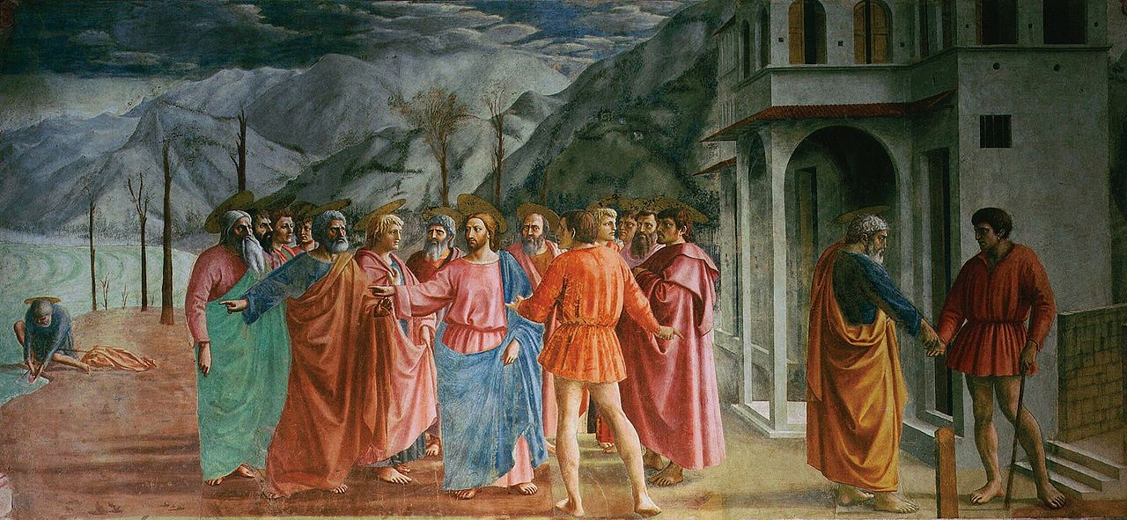
The Tribute Money (1420) Brancacci chapel, Florence

Slide 8
The Tribute Money (1420) Brancacci chapel, Florence
https://youtu.be/oDPNSPbjzQ8
Used technique of (a continuous narrative) which was also used by the ancient Romans—Masaccio is able to make an entire drama unfold on the wall of the Brancacci chapel divided in three parts of the story
Christ says to Peter “so that we may not offend them, go to the lake and throw out your line. Take the first fish you catch; open its mouth and you will find a four-drachma coin. Take it and give it to them for my tax and yours” (Matthew 17:27). Christ performed a miracle—and the apostles have the money to pay the tax collector.

Slide 9
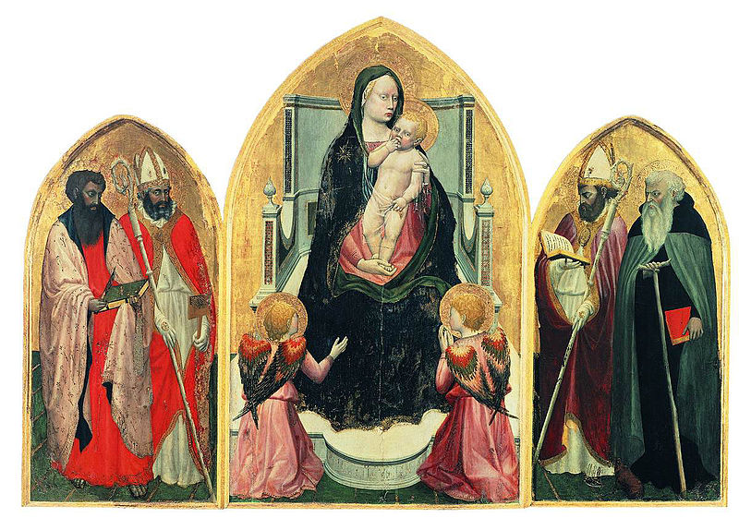
Virgin and Child, San Giovenale Triptych (1422)

Slide 10
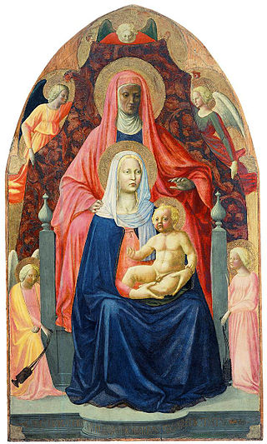
Virgin and Child with Saint Anne (1424)

Slide 11
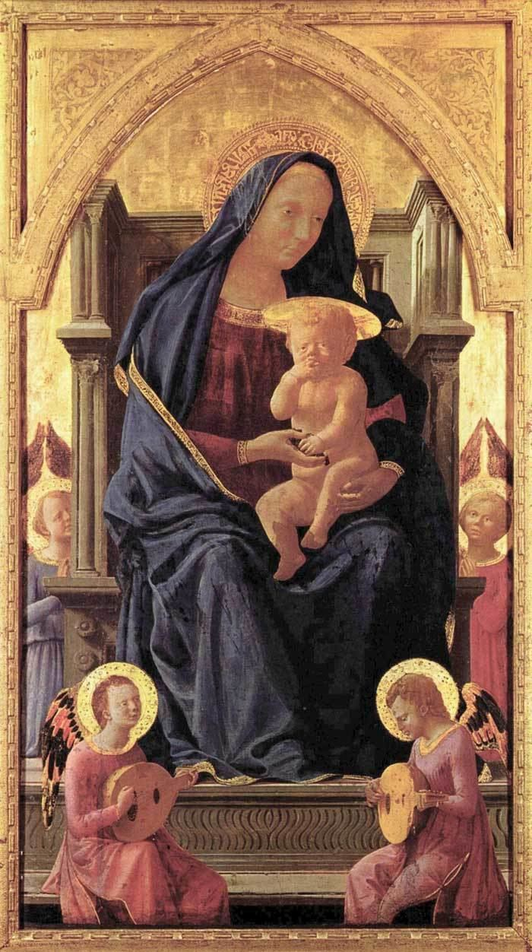
Madonna and Child (c. 1426)

Slide 12
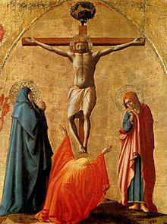
Crucifixion from Pisa Altarpiece(c. 1426)

Slide 13
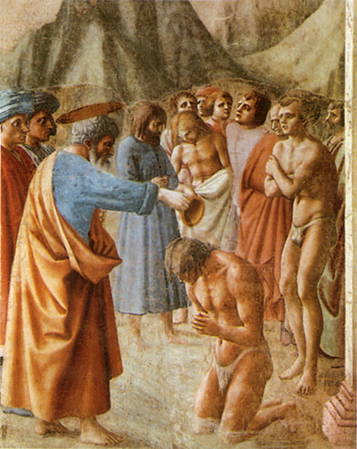
The Baptism of the Neophytes (1425-28)

Slide 14
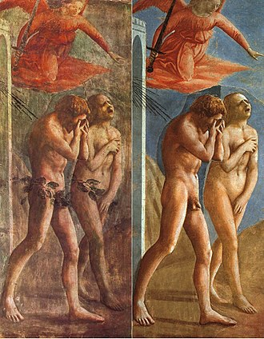
The Expulsion of Adam and Eve from the garden of Eden (1426)

Slide 15
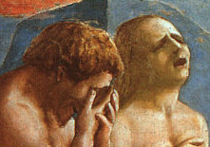
Close-up of ‘The Expulsion’ (1426)

Slide 16
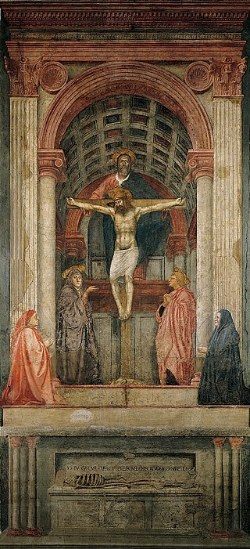
Holy Trinity (c. 1426-1428)

Slide 17
English Translation:
“I was what you are and what I am, you shall be” https://youtu.be/Kl4Dcj9o570

Slide 18
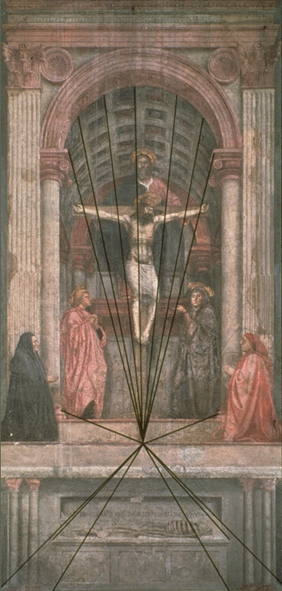
A perfect example of linear perspective

